Slide 1
How to use Patchs
WINSTON CHURCHILL THEATRE 17TH august 2024

Slide 2
Why Use Patchs:
Save time – Easy to use, no more frustrating waits trying to get through via your GP’s phone line
More control – track the status of your query from your smartphone
Greater accessibility – Patchs will be open 7am till 5pm.
Be prioritised – if your query is urgent, your GP will know, and you will be given priority according to the severity of your symptoms
Manage your health – request health advice, sick (fit) notes, prescription medication & more
Easy to use – create a Patchs account on your phone, tablet or computer

Slide 3
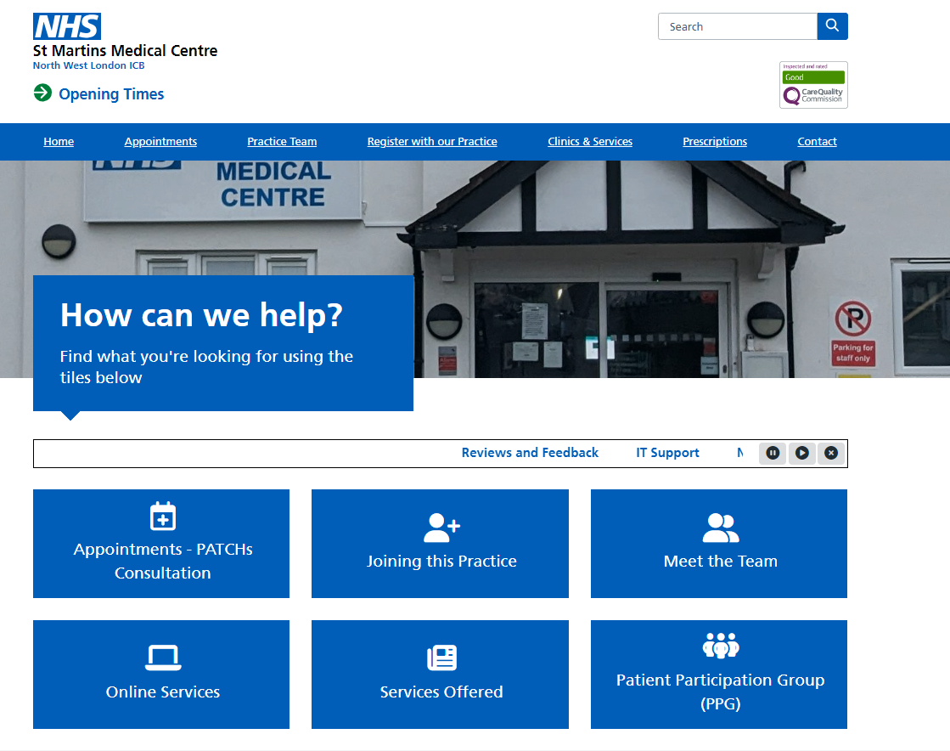
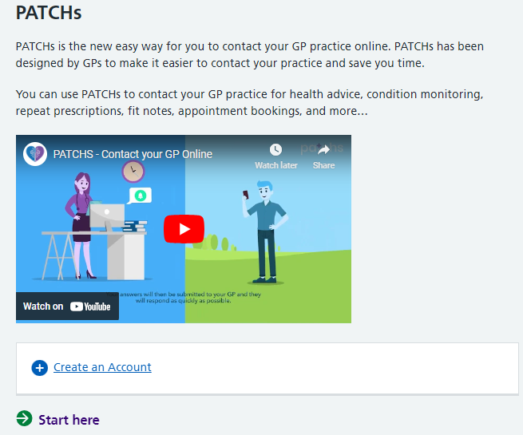
How do I get started with Patchs?
First, click on the link to Patchs on St Martins Medical Centre website:
https://www.stmartinsmedicalcentre.co.uk/

Slide 4
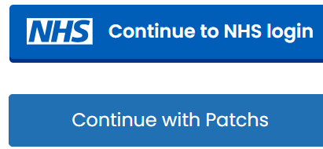
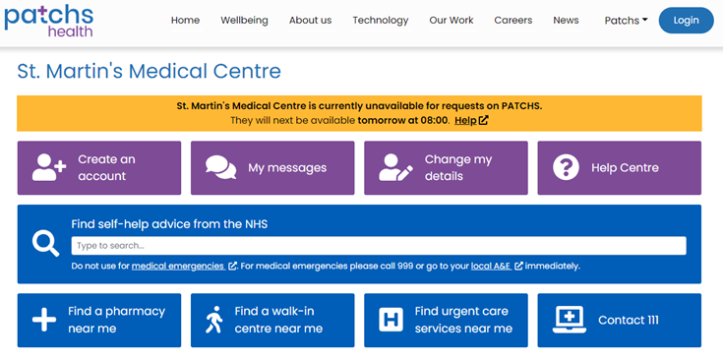
Follow the steps to create an account:
After assisting numerous patients at the surgery, I have observed that there are issues with patients' NHS logins which are causing difficulties in accessing Patchs, or errors occur when trying to log in. Therefore, creating an account directly through Patchs is the most efficient method to ensure seamless access to the service.
Select create an account

Slide 5
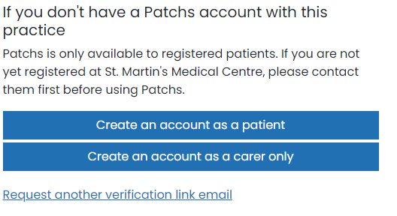
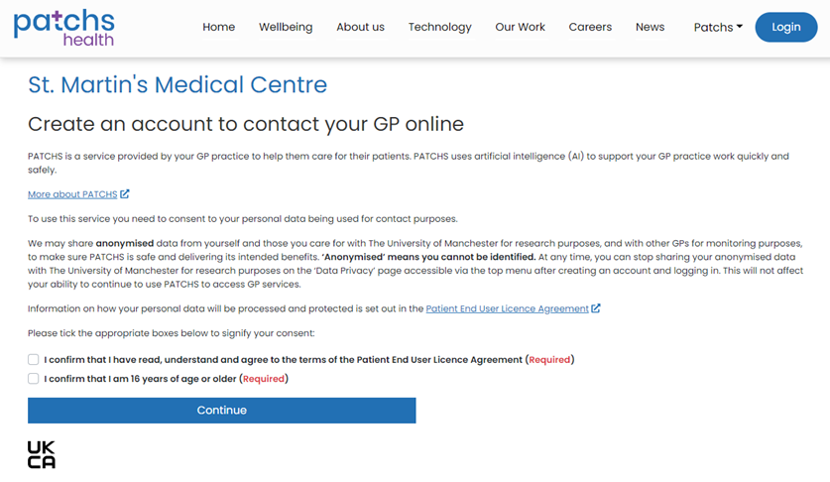
After selecting "Continue with Patchs," create an account using the option that best applies to you. Next, you will be prompted to confirm that you have read and agreed to the terms and conditions, and to verify that you are 16 years of age or older.

Slide 6
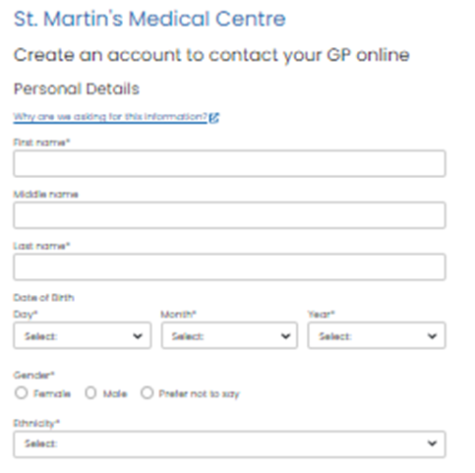
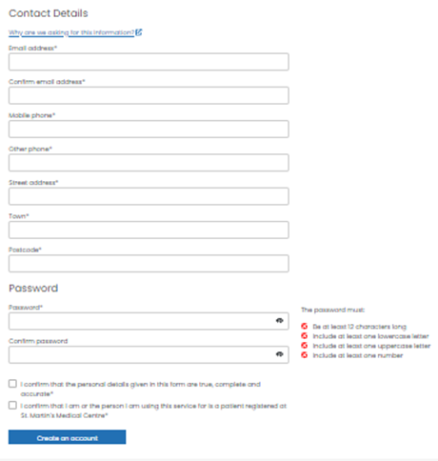
After accepting the terms and conditions, you will be asked to provide your personal and contact details. Once all the required information has been entered, please press "Create Account."

Slide 7
Once you have created your account, a verification link will be sent to your email. Please click this link to verify your account before attempting to log in, as you will not be able to log in otherwise. If you cannot find the verification email, please check your junk mail folder or raise your hand for assistance.

Slide 8
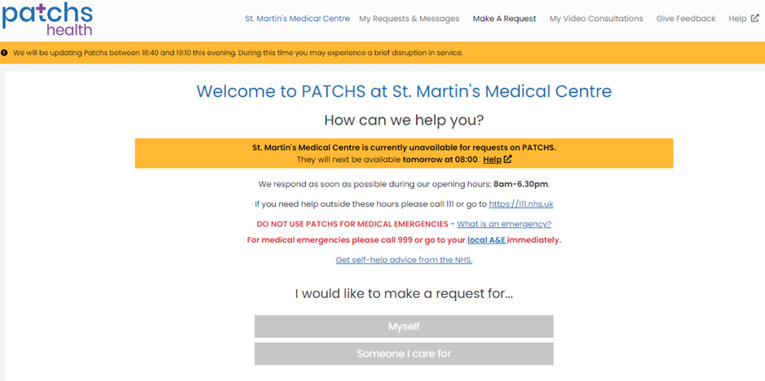
Once you have verified your email, you will be directed to the PATCHS request page. Here, you can submit a PATCHS request either for yourself or on behalf of someone you care for.

Slide 9
Once you have selected either "Myself" or "Someone I care for," you will be directed to a new page. Here, you will need to choose the type of assistance you require from the GP practice: New Health Problem, Ongoing Health Problem, Admin Request, Medication Request, or Other, which is something that doesn’t fall into the above categories.

Slide 10
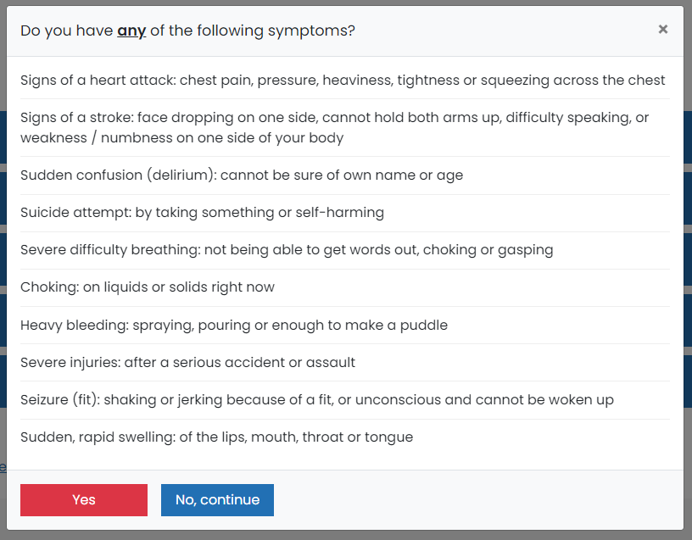
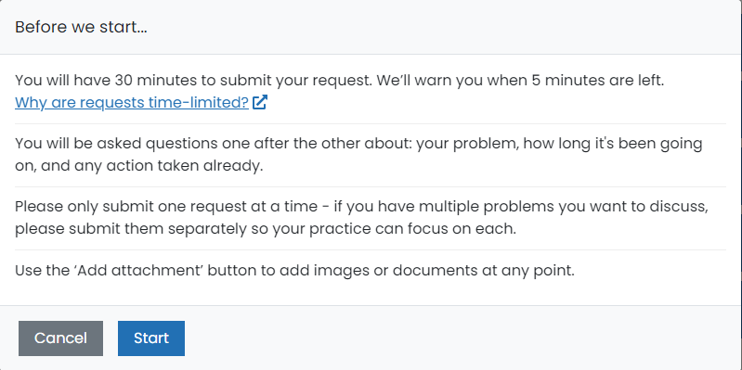
After selecting how the GP practice can assist you, please review the list of symptoms and indicate whether you are experiencing any of them by clicking "Yes" or "No." When you reach the "Before We Start" page, note that you will have 30 minutes to complete and submit your request, with a warning provided when 5 minutes remain. You will be asked a series of questions, one after the other. Please submit only one request at a time. For multiple requests, send them separately. Use the "Add Attachment" button to include images or documents at any point.

Slide 11
For example, I will use a test dummy account to demonstrate how to book an appointment with PATCHS in the following slides.

Slide 12
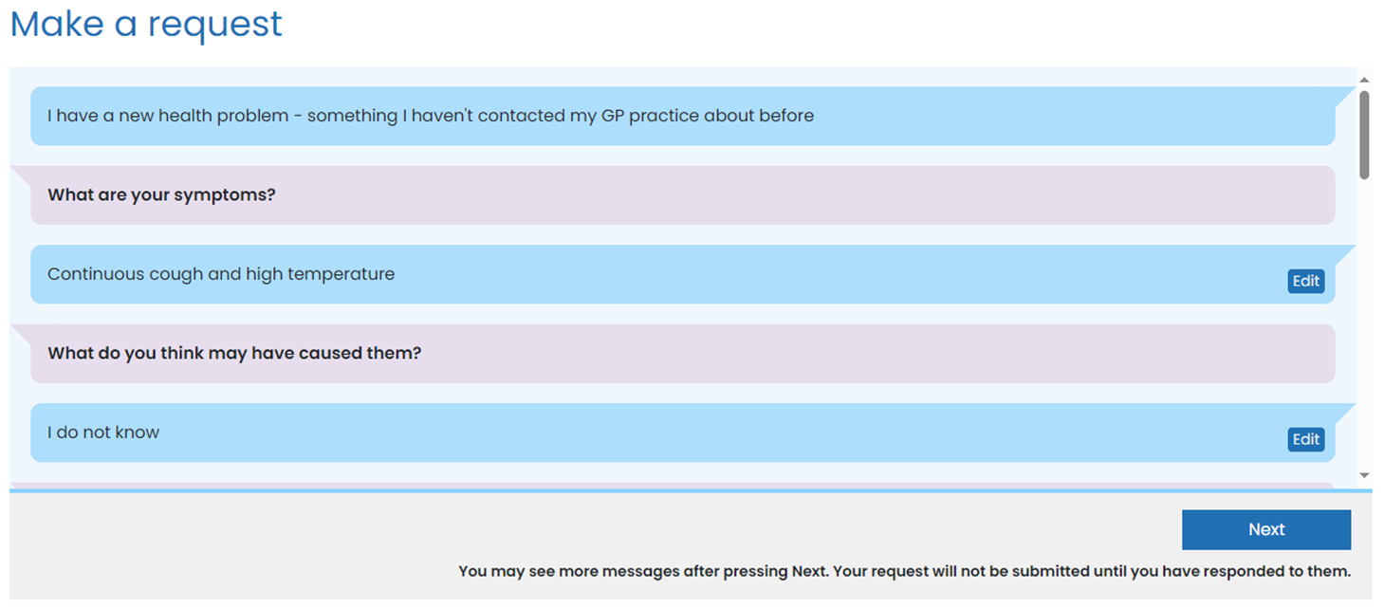
For this example, I have chosen "New Health Problem" – Continuous cough and high temperature. I followed through the questionnaire, answering each question in detail and to the best of my ability. This ensures that the clinician reviewing the request can determine the best outcome.

Slide 13
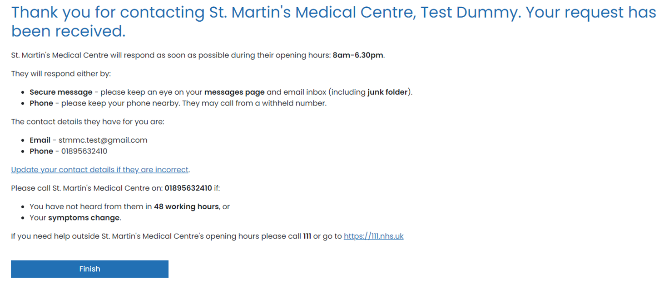
Finally, after completing the questionnaire, you will reach this page. The PATCHS request will then be sent to the GP practice, where a clinician or the most suitable staff member will address your request.

Slide 14
This is how we receive your Patch request on our end. The most appropriate clinician will review and address your request.

Slide 15
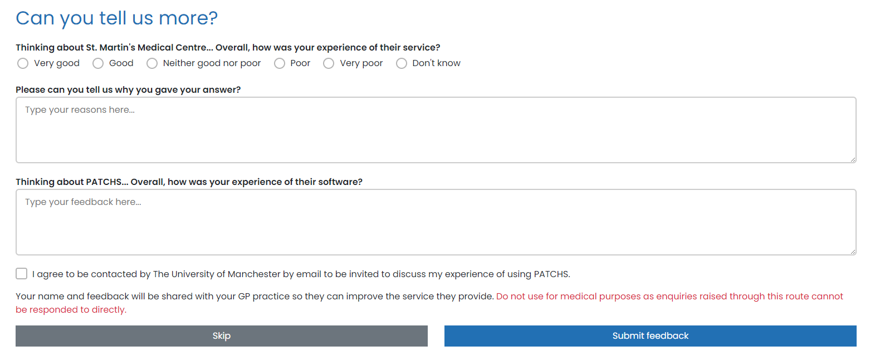

Slide 16
Who to contact for any queries or concerns:
IT Leads of the Practice ~ Guste and Kabi ( Monday – Friday )
nhsnwl.stmmcfax@nhs.net
Telephone: 01895632410
We appreciate your understanding and humbly request your cooperation and patience, as we implement this system, designed to enhance your healthcare experience. Please help us to help you.
Thank you,
St. Martin’s Medical Centre.

Slide 17
Thank you for your time and attention. I hope you found the presentation informative and engaging. We will now be able to answer any questions you may have. Please feel free to ask!

